Slide 1
STATE OF TEXAS v BURTON KIRK HEAD

Slide 2
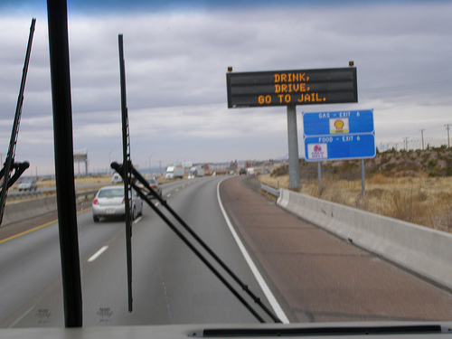
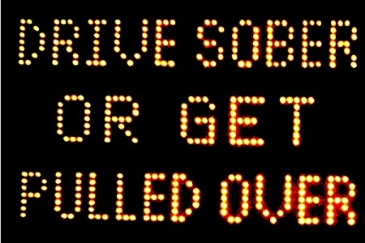
DRINKING
Drink, Drive, Go to Jail
Drive Sober or Get Pulled Over
Going Out Tonight, So Are We

Slide 3
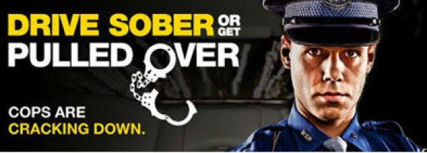

Slide 4
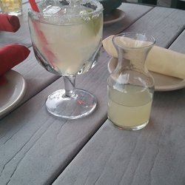
NOT ILLEGAL TO DRINK AND THEN DRIVE; as long as you’re NOT intoxicated

Slide 5
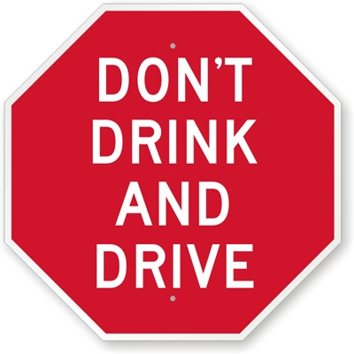
BUT, WHO STILL SAYS…

Slide 6
DRINKING PATTERNS
A. REGULARLY
B. OCCASIONALLY
C. RARELY
D. NEVER
E. NOT ANY MORE

Slide 7
ALCOHOL
MEMBER OF MADD
MEMBER OF AA
STRONGLY AGREE WITH “NO REFUSAL” WEEKENDS
ALCOHOLISM IN FAMILY
NO ALCOHOL IN HOME
INJURED/VICTIM OF ALCOHOL RELATED CRIME

Slide 8
RELATED TO?

Slide 9
DWI v. PI

Slide 10
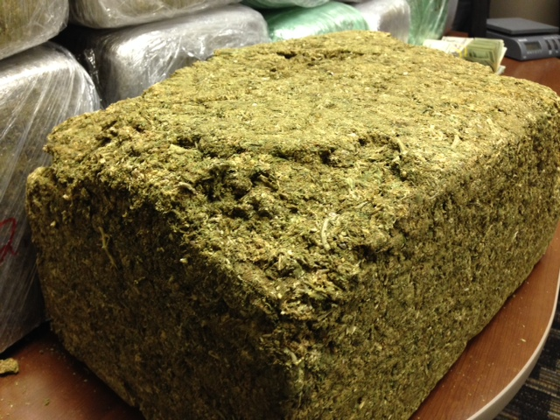

Slide 11
DWI v. PI “OPERATING” A MOTOR VEHICLE

Slide 12
ALCOHOL
MENTAL FACULTIES
PHYSICAL FACULTIES
MUST BE DUE TO INTOXICATION
AT THE TIME OF DRIVING

Slide 13
AT THE TIME OF DRIVING
Retrograde Extrapolation
Factors that Can Affect This?
Person: Height, Weight, Gender, BMI
Eating: Amount, Type, Time
Drinking: Size, Number, Rate, First, Last, History of Drinking that Night and Social, Family Drinking Patterns, Liver, Kidneys, Metabolism, Hydration Level, Diet, Hematocrit level, Absorption, Distribution, Elimination rates, Stress, etc…

Slide 14
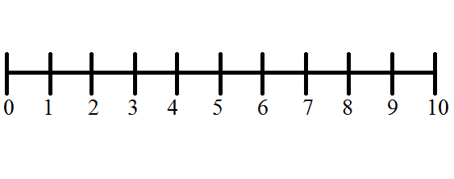
PRESUMPTION OF INNOCENCE
INNOCENT GUILTY

Slide 15
ASSUME
v.
PRESUME

Slide 16
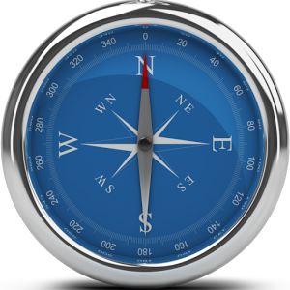
PRESUMPTION OF INNOCENCE

Slide 18
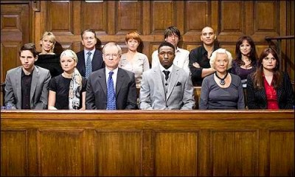
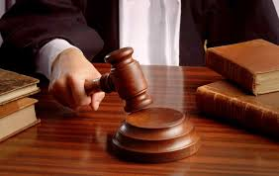
JURY SERVICE

Slide 19
THANK YOU

